Slide 1




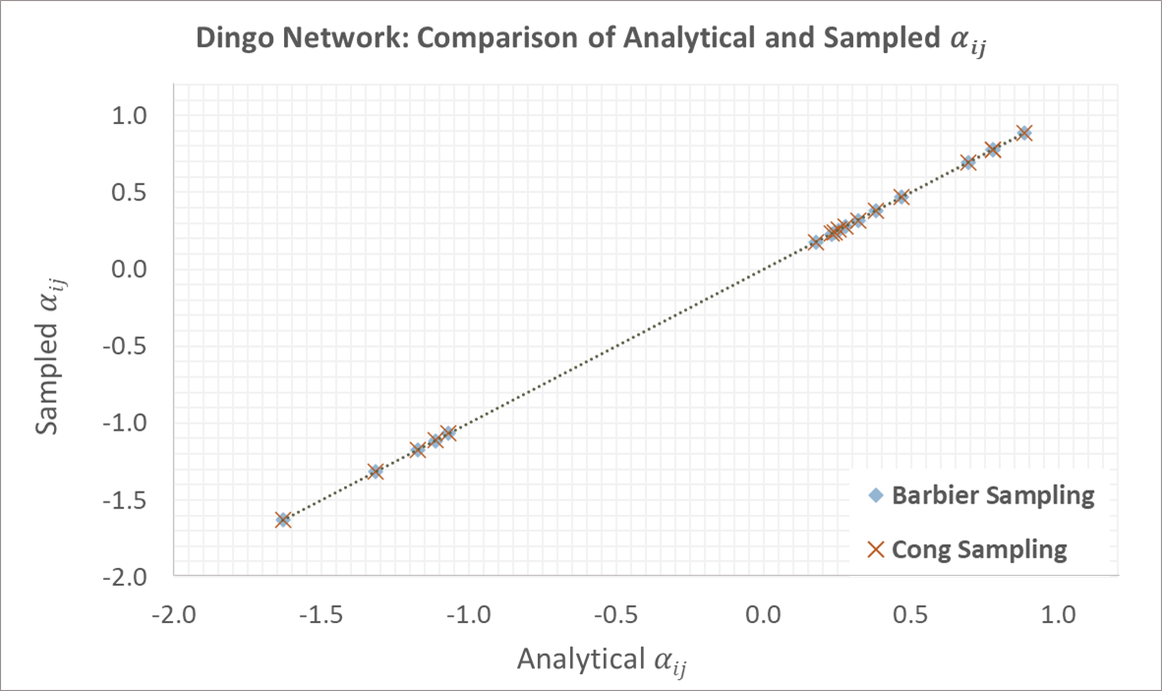
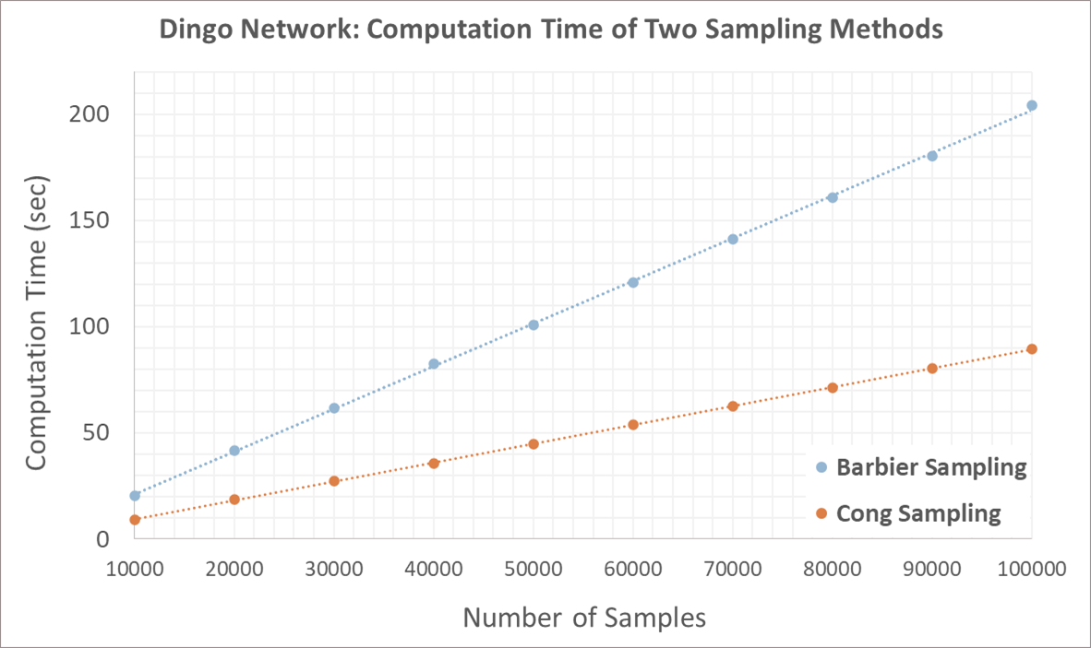




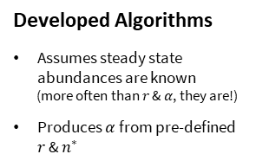

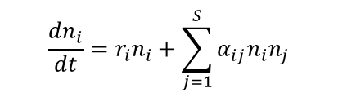

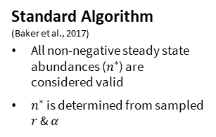

Realistic Ensemble Ecosystem Modelling
Author: Thomas Pham Supervisors: Dr Matthew Adams, Sarah Vollert
Objectives
Motivation
Methods
How could we better utilise available data to
improve the realism of the EEM generation process, without introducing excessive computational cost?
Dingo
Standard Algorithm
(Baker et al., 2017)
All non-negative steady state abundances ($n^{∗}$) are considered valid
$n^{∗}$ is determined from sampled $r$ & $α$
Developed Algorithms
Assumes steady state abundances are known
(more often than $r$ &$α$, they are!)
Produces $α$ from pre-defined $r$ & $n^{∗}$
Large Herbivores
Mesopredators
We could model based on known abundances!
Model
Population
Generalised Lotka-Volterra Equations
Grasses
Small Vertebrates
$$r$$
$$α$$
$$r$$
Interaction Strength
$$+$$
$$+$$
$$\frac{dn_{i}}{dt}=r_{i}n_{i}+\sum_{j=1}^{S}{α_{ij}n_{i}n_{j}}$$
Time
Growth Rate
Fire
100 Dingoes
(realistic)
Strongest Positive
Effect
Ensemble ecosystem modelling (EEM) allows us to predict how an ecosystem network may respond to some change
Soil Quality
Invertebrates
Species
Abundance
$$α$$
We need to find a set of parameters {$r,α$} that can model a network
: Effect of node $j$ on node $i$
50000 Dingoes (unrealistic)
Key Results
Conclusions
Strongest Negative
Effect
Our modelling algorithms account for realistic abundances.
+
Developed a fast sampling method!
Future Work
Enforcing network stability
References
Baker, C. M., Gordon, A, & Bode, M. (2017). Ensemble ecosystem modelling for predicting ecosystem response to predator reintroduction. Conservation Biology, 31(2), 376-384.
Equivalent Parameter Estimates
2x Faster Computation

